Slide 1
Roy Lichtenstein
1923-1997

Slide 2

Roy Lichtenstein
1923-1997, New York
Painter
Sculptor
One of the leading figures of the Pop Art movement
Poked fun at art and commercialism
Notes:
Lichtenstein was born and raised in Manhattan, New York. As a painter and sculptor, he was one of the most important figures of the Pop Art movement (Pop artists used "popular" items for subjects such as common, everyday items and images from advertising). Lichtenstein liked to use his art to poke fun at the ideas of art and commercialism.

Slide 3
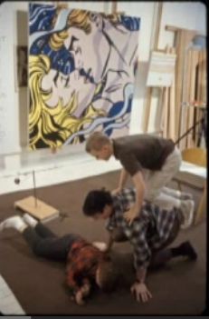
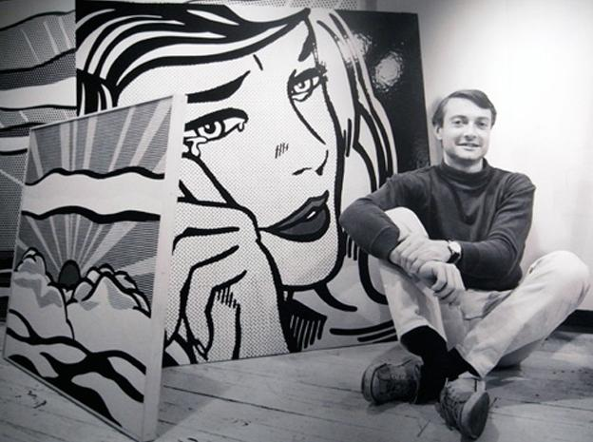
Roy Lichtenstein in studio, playing with sons
Notes:
Here he is with his sons, Mitchell and David. You can see that many of his paintings are very large.

Slide 4
What to Look for in his Artwork
Solid black lines
Limited color palette, mostly primary colors
Ben-Day dots
Inspired by comic books, advertising
Notes:
Notable traits of Lichtenstein's art include bold, dark lines; a limited color palette, mostly primary colors; the use of Ben Day dots; and subjects inspired by comic books & advertising.

Slide 5
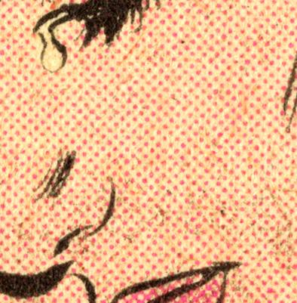
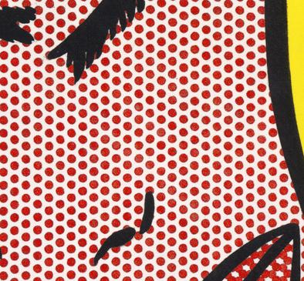
Ben Day Dots
Notes:
Benjamin Henry Day invented this printing technique in 1879. Depending on the effect required, dots are closely spaced, widely spaced, or overlapping (to blend colors). For a long time color printing was done with just four colors: Cyan (a blue-green), Magenta (a pink-purple), Yellow & Black. Magenta dots, for example, are widely spaced to create the look of pink skin. On the right you see Lichtenstein's enlarged and exaggerated take on Ben Day dots.

Slide 6
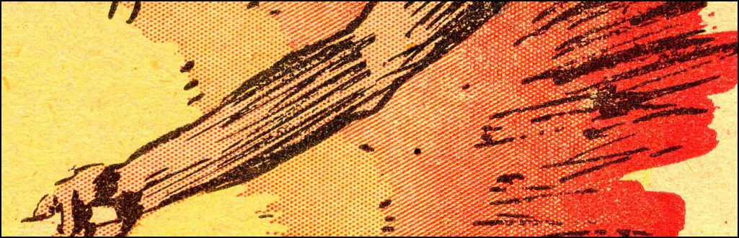
Ben Day dots for shading
Notes:
Here you can see an image of an arm. The background is yellow, and where the skin begins there are widely spaced reddish dots to look like peach skin. As the dots are placed closer together, the background starts to look more orange, then more red, and finally solid red.

Slide 7
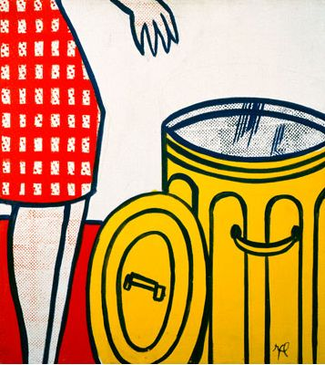
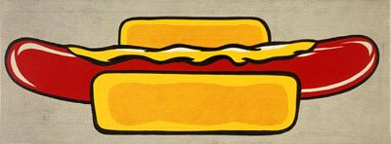
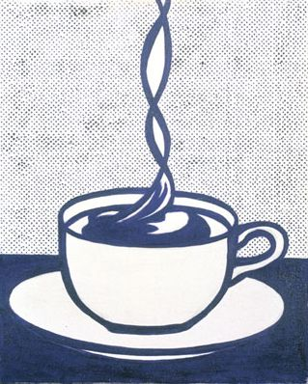
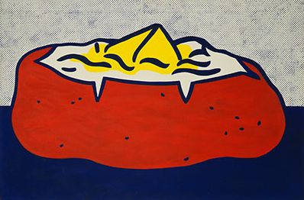
Odd subjects – 1961-1963
Notes:
Artists of the Pop Art movement liked to use everyday objects as the subject for their works. You may be familiar with Andy Warhol's soup cans. Lichtenstein gravitated toward what he would call the “dumbest” or “worst” visual item he could find and then tried to alter or improve it. Some people were not sure if a painting of a hot dog or baked potato could really be considered art. What do you think? Lichtenstein didn't like the idea that one set of lines (one person’s drawings) “was considered brilliant, and somebody’s else’s, that may have looked better to you, was considered nothing by almost everyone.”

Slide 8
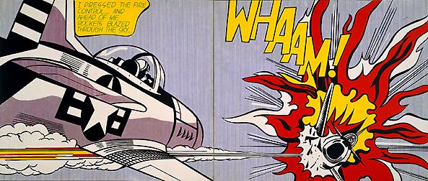
Whaam! – 1963 oil and Magna on canvas, diptych, 68”x166” overall
Notes:
Lichtenstein was inspired by comic books. He often copied scenes from DC Comics--they're the folks that make Batman and The Flash! But, back then, they also made war story comics and even romance story comics. Lichtenstein liked to copy important scenes in these stories and paint them in his own style. Some people thought this made him just a copy-cat. They didn't think it was really art. But the comic book companies at the time didn't even give their own artists named credit for drawing the comics, so maybe Lichtenstein was actually showing people that their drawings could be considered art?

Slide 9
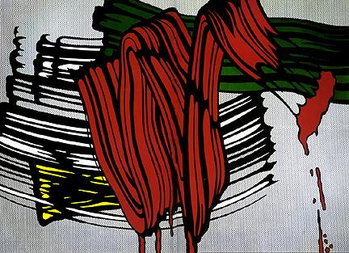
Big Painting #6 – 1965
Brushstroke series, oil and Magna on canvas, 92.5”x129”
Notes:
Lichtenstein wanted to move on from painting comic book scenes and began a series of brushstrokes. He was poking fun at art because the viewer usually notices the subject not the strokes of the brush used to paint it. But this time he chose the brushstroke, itself, as his subject!

Slide 10
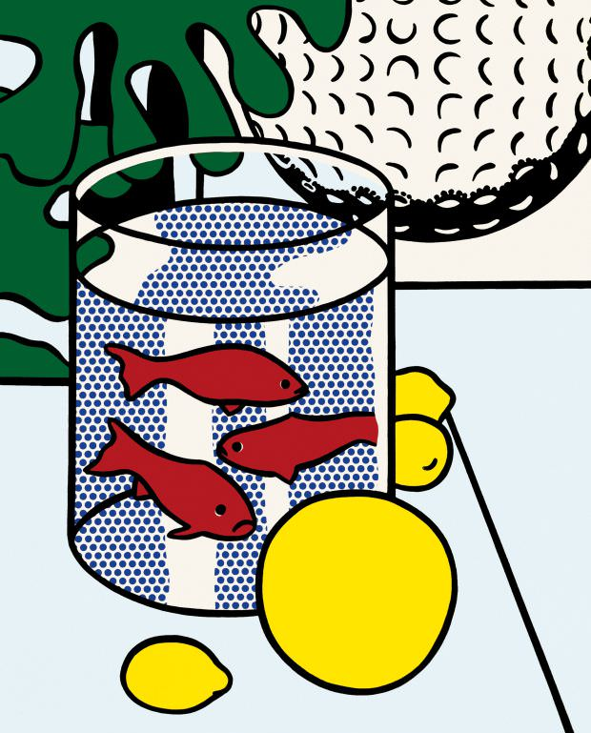
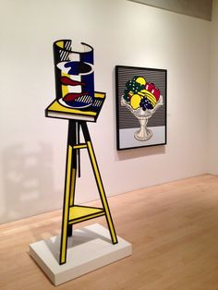
Still Life with Goldfish – 1972 / 1977 oil and Magna canvas, 52”x42” / painted bronze, 77.5”x25.5”x18.25”
Notes:
Later in his career, Lichtenstein also started making sculptures. Sometimes he would make a sculpture of a painting that he had already made years before. And even though his sculptures were three-dimensional, they almost looked like flat paintings!

Slide 11
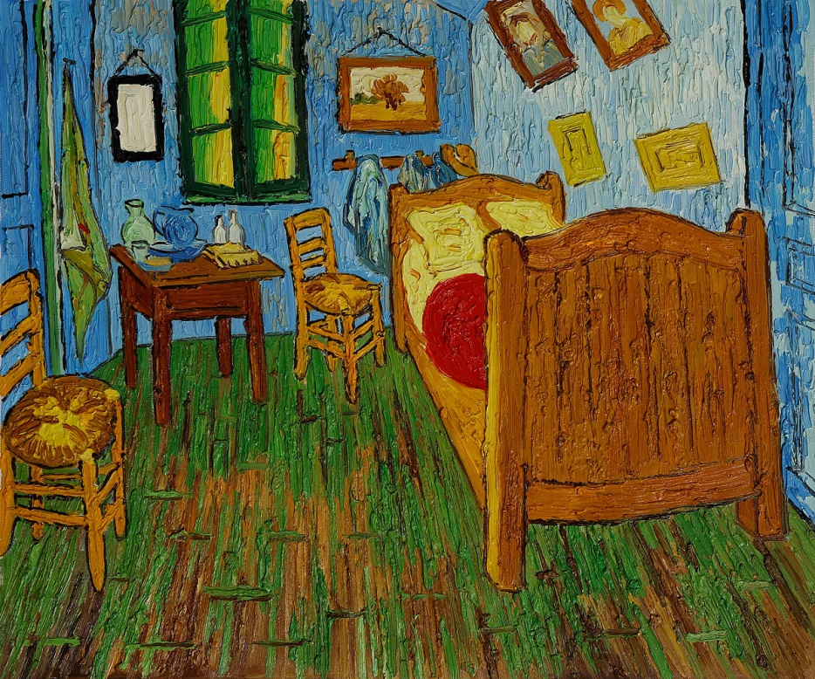
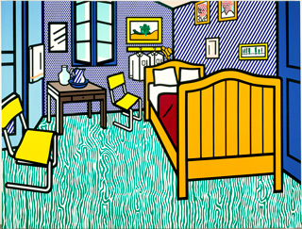
Bedroom at Arles – 1992 based on Van Gogh’s “Bedroom in Arles”, 1888 (orig.28”x35”)
Notes:
Lichtenstein also liked to explore works by famous artists. Here, Lichtenstein has put his own spin on a painting by Vincent VanGogh.

Slide 12
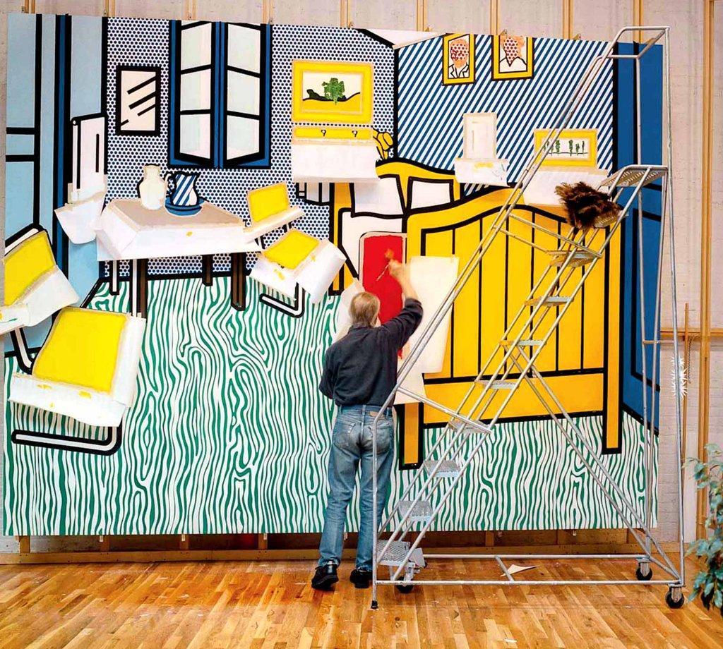
Bedroom at Arles – 1992 oil and Magna on canvas, 126” x 165.5”
Notes:
It's REALLY big!

Slide 13
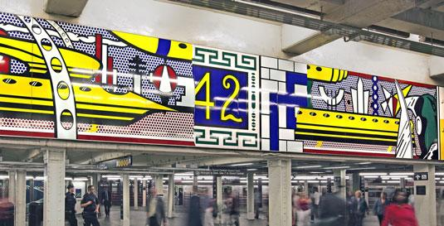
Times Square Mural – 1994 porcelain enamel on steel, 72”x 53’ overall (16 panels)
Notes:
He even made a mural for the New York subway. It is an amazing 53 FEET long!

Slide 14
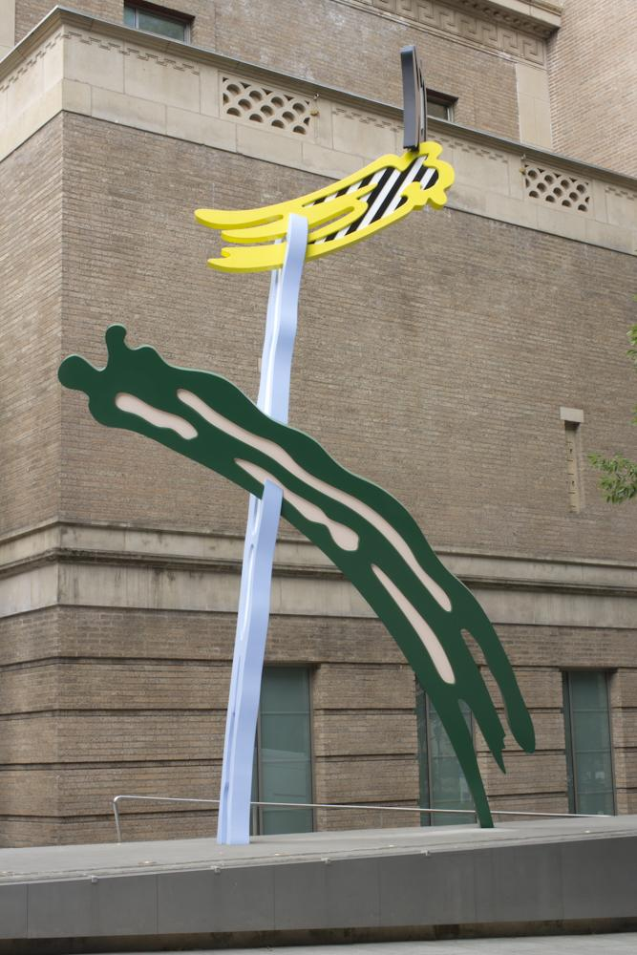
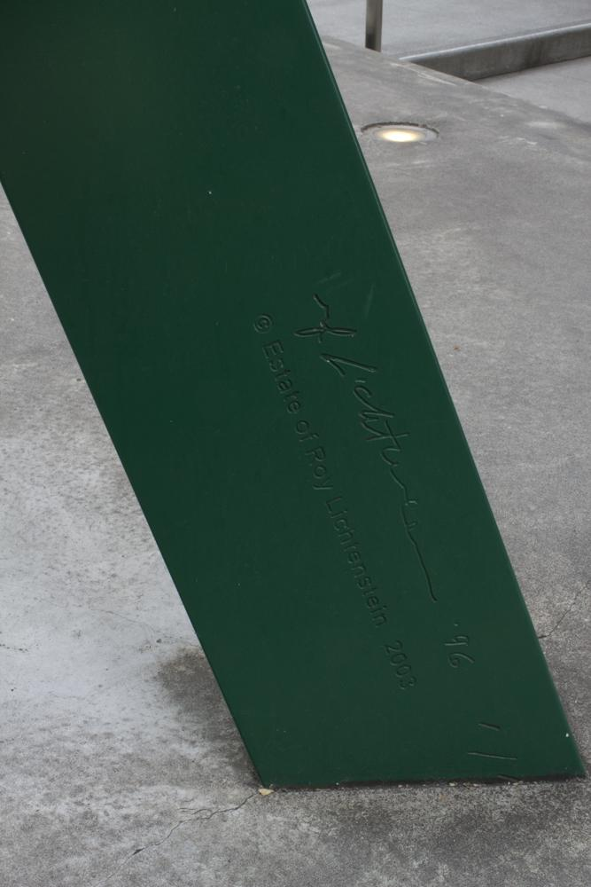
Lichtenstein in Portland!
Brushstrokes – 1996 painted aluminum, 29.5’ tall
Notes:
Yes, you can see a Lichtenstein Brushstroke sculpture outside our own Portland Art Museum downtown. It is on Park Avenue in front of the grey building to the right of the main museum building.

Slide 15
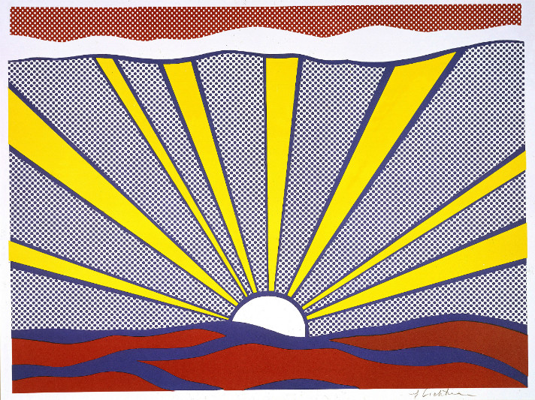
Sunrise – 1965 offset lithograph on white wove paper, 18.3”x24.3”
Notes:
And now, our project.

Slide 16
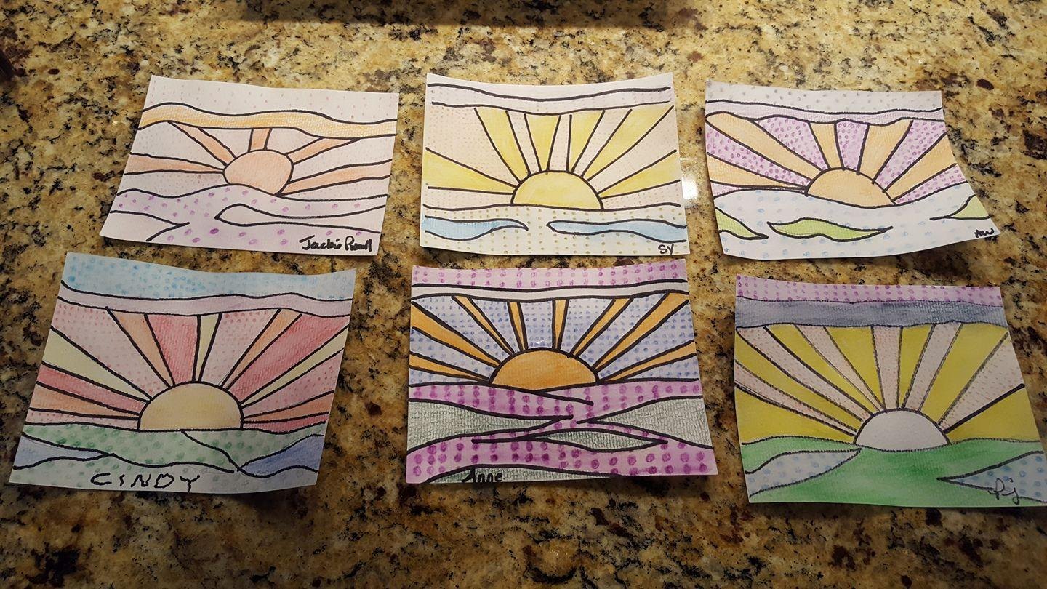
Sunrise - Student Examples
Notes:
Here are some examples of how other students have interpreted Lichtenstein’s sunrise. You can see that some made the bottom section water while others made it land and some made it more clouds. A variety of colors were used - this is your art so you decide!

