Slide 1
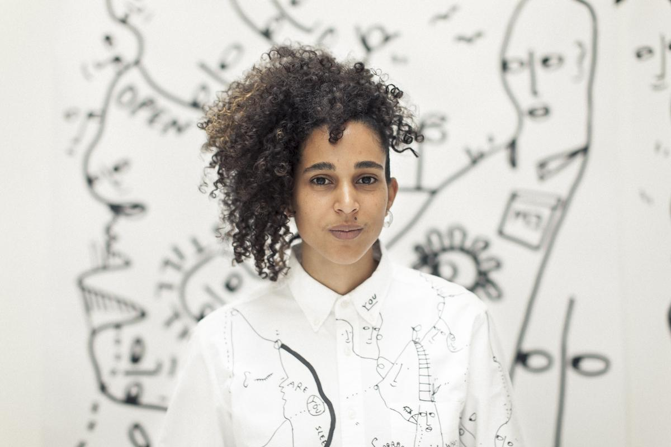
Shantell Martin
1980-Present
The Art Lit team at Metzger Elementary School created this presentation! Thank you!!

Slide 2
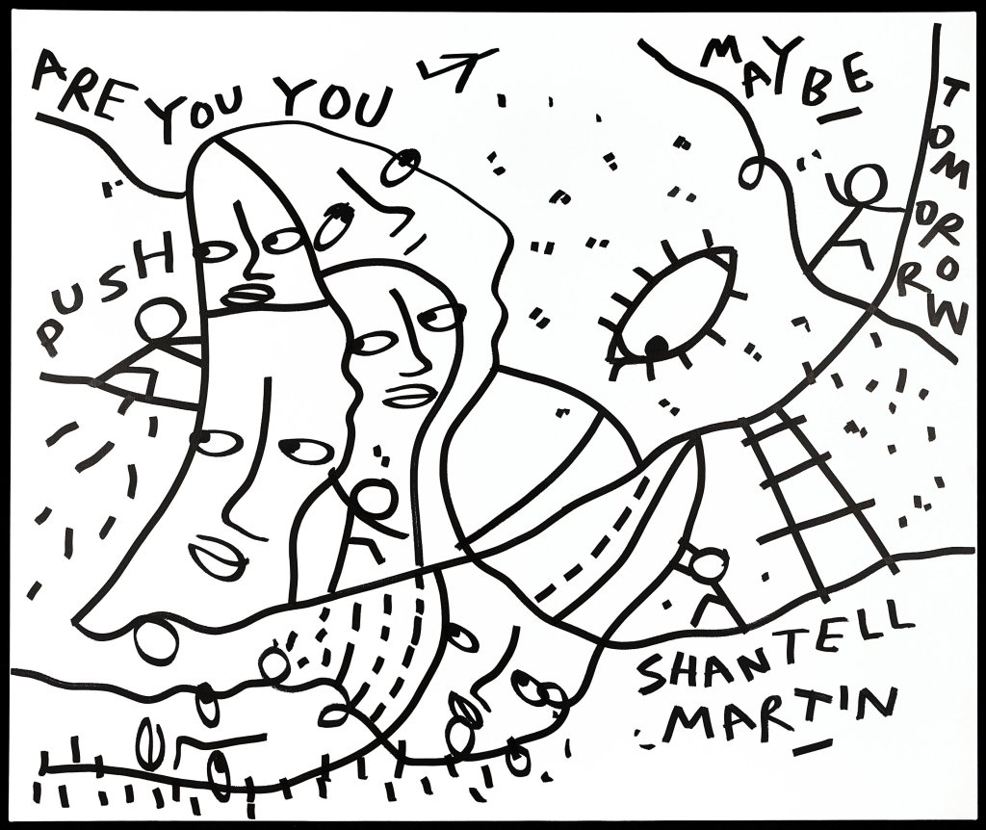
Martin’s Style
Style: Contemporary, Improvisational
Mediums: Drawing
Tools: Markers, Pen, Spray Paint
Main Art Elements: Line, Shape, No Color
She went to art school in London and then went to Japan where she began her career.
©Shantell Martin
Notes:
Image Source: https://icon.ink/articles/shantell-martin-interview-absolut-art-collaboration/
Martin's work is a meditation of lines; a language of characters, creatures and messages that invites viewers to share a role in the creative process.

Slide 3
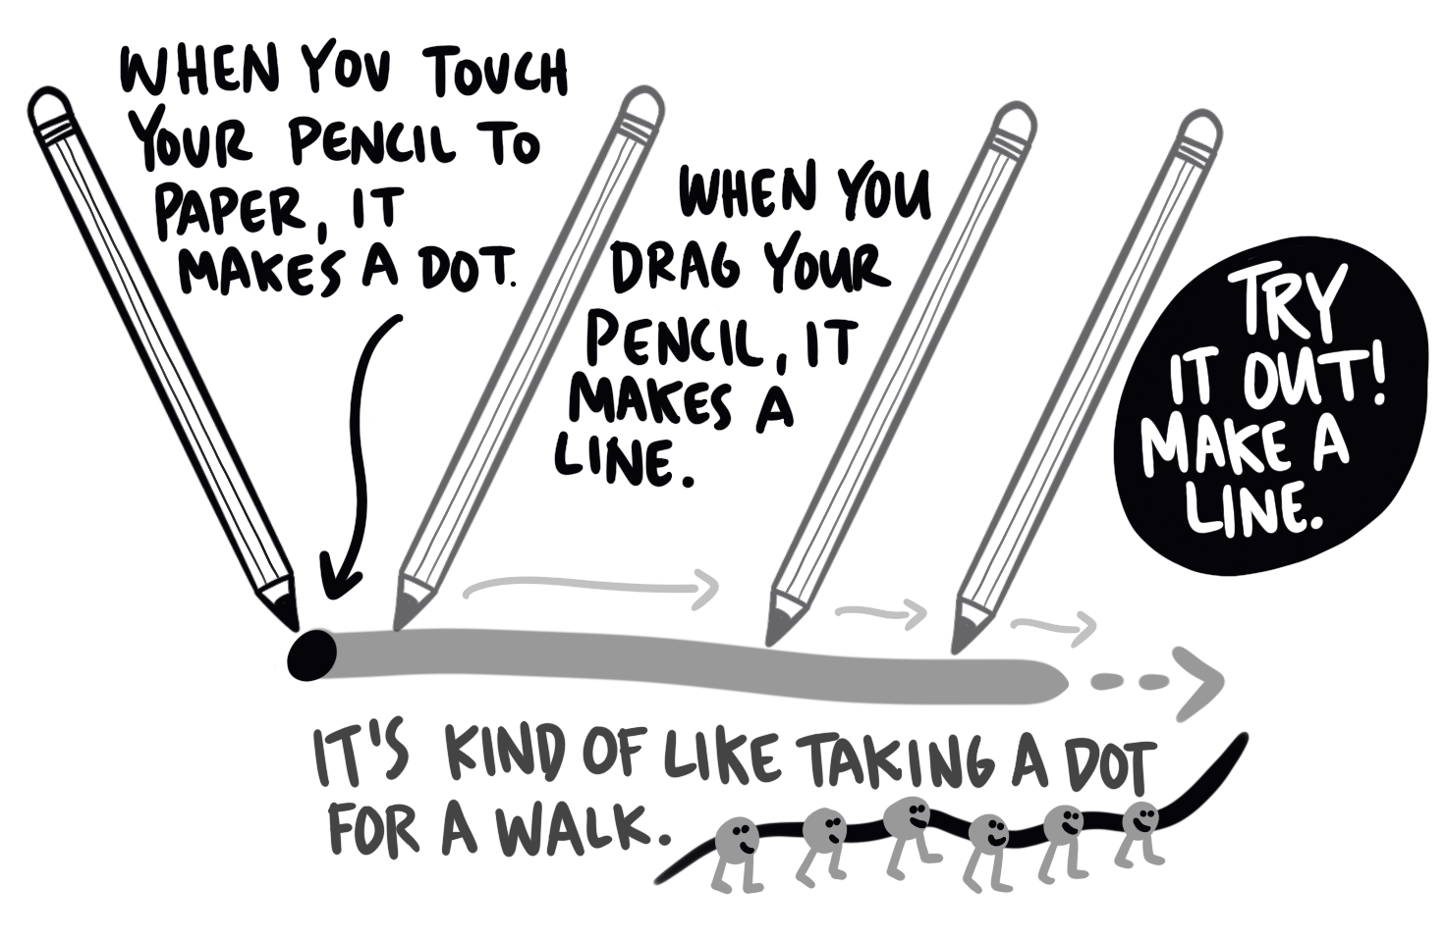
ART ELEMENT: LINE
“This initial line for me is the DNA. It’s the structure. It’s the foundation of the drawing. It’s what holds it all together.”
Notes:
Line is the primary element in Martin’s work. She has worked very hard to create lines that anyone would recognize as her lines. A line is essentially a dot that you take for a walk.
She says her art starts with a line and then she adds other elements like faces, words, or symbols into the drawing.
Quote Source: https://shantellmartin.art/work/a-life-in-lines/

Slide 4
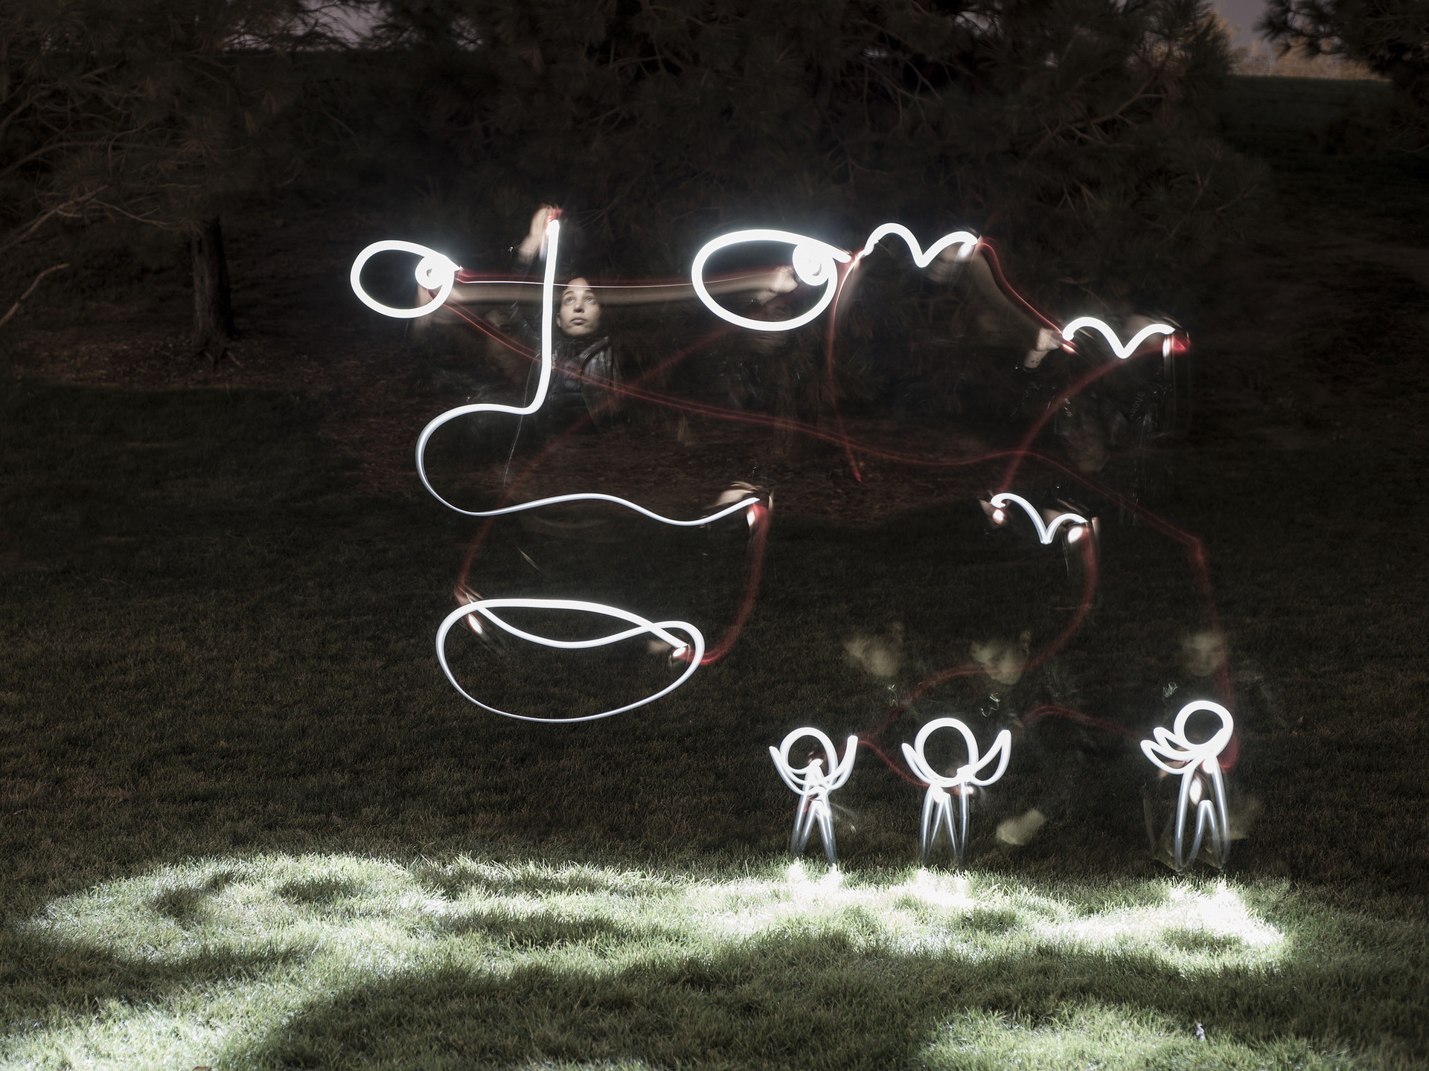
Faces
Photo By: Jon Paciaroni
Drawing with a flashlight in the dark.
Notes:
Faces are also featured prominently in her work.
Project Link: https://shantellmartin.art/work/light-drawings/
Image Source: Shantell Martin Press Kit, https://shantellmartin.art/info/

Slide 5
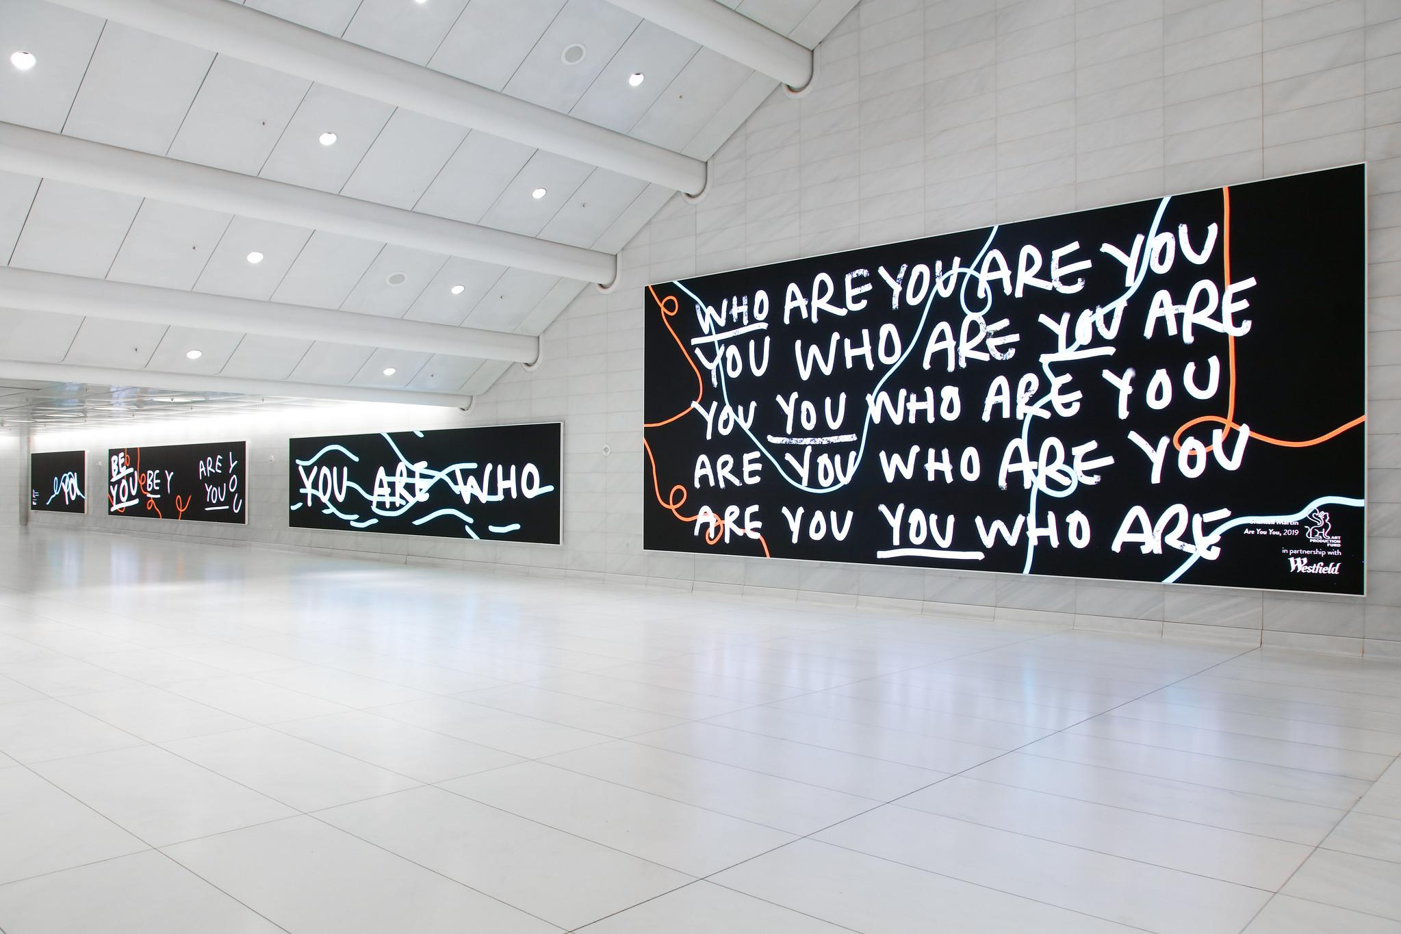
Words
Photo by: Steven Simione
The Oculus, World Trade Center, 2019
Notes:
Words feature prominently in Martin’s work often expressing ideas, thoughts or questions. Her works become a combination of drawing and writing. The combination can inspire the viewer of the piece in ways differently than an artwork without words.
About the artwork from: https://shantellmartin.art/work/the-oculus/
“For Art Production Fund's third installment of their video art program, they commissioned Shantell Martin for a site-specific video piece. The video work appeared on Westfield World Trade Center’s 21 screens of varying sizes, with one measuring four stories tall and another 280 feet long. This new work by Martin explores some of the questions and repetitions we find ourselves asking: Are You being You? Are You being true? Who are You? Are you YOU Permutations of the same questions are repeated throughout the work and resonate in viewers in both subtle and more profound ways.
The work intentionally plants questions for viewers to reflect upon and to consider as they pass through the center whether heading to work or on their way home. These illustrations were designed by Martin on a digital tablet and were collected and animated by collaborator Optical Animal.
“The World Trade Center is my route home most of the time and these are the thoughts I've had in the space often that will now be visible on the screens.” – Shantell Martin.”
Project: https://shantellmartin.art/work/the-oculus/
Image Source: Shantell Martin Press Kit, https://shantellmartin.art/info/

Slide 6
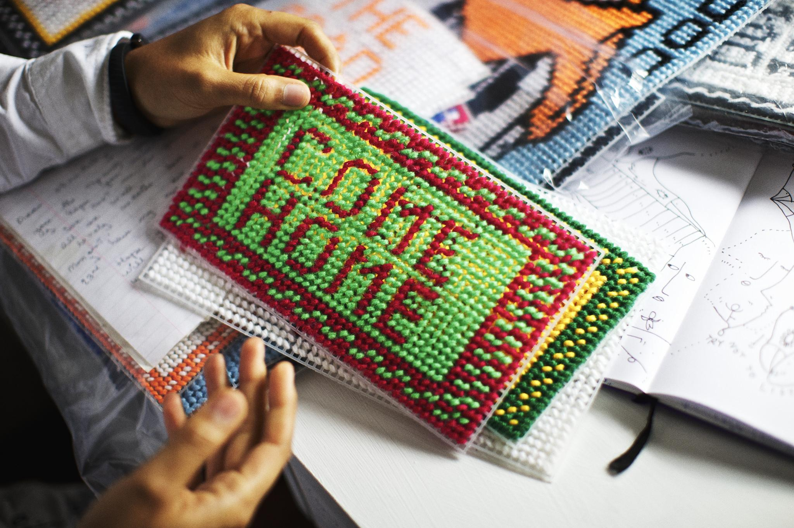
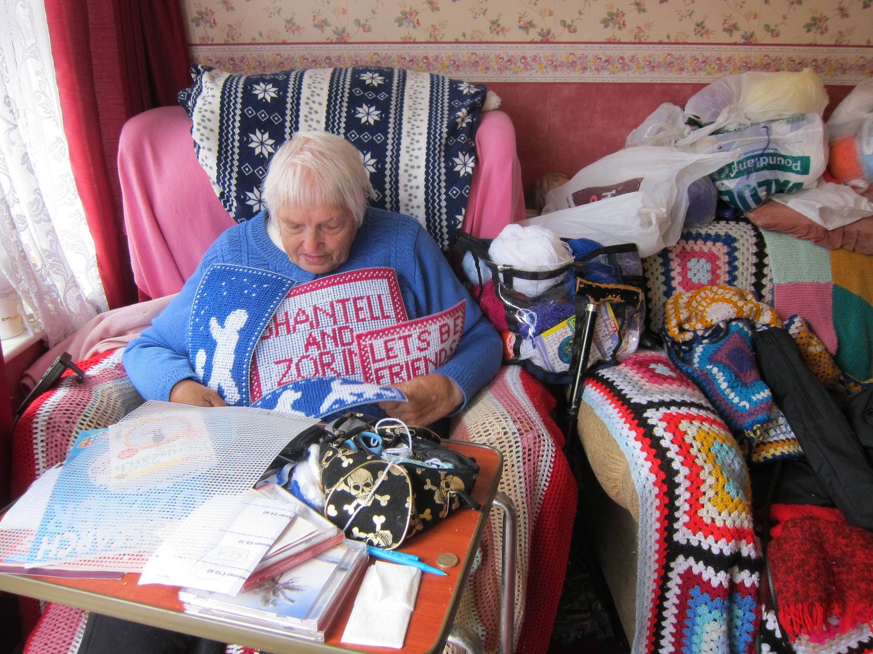
Collaboration: Shantell and Dot
Photo Credit: Where They Create
Photo Credit: www.shantallmartin.com
Notes:
“Martin’s “Dear Grandmother” collaboration was born over a decade ago when Martin commissioned her grandmother, Dot Martin, to embroider her “Half White” series as a reflection on racial identity. Since then, the pair have worked on over 70 pieces together, with Dot adding her own touches of color or language along the way. Martin sees the pieces as symbolically bridging gaps of distance, generation, race and culture, creating an inclusive backdrop for artistic creation.
With phrases like “Come Home” / “Go Home”, “British” / “English,” the pieces are both challenging yet comforting, and playful yet ironic. With Dot Martin passing away in October of 2015 at the fine age of 80-Something (Dot never did tell anyone her actual age), Shantell felt extremely grateful that she was able to find such a fun and creative way to collaborate with her Grandmother before her passing and that the work they collaborated on was exhibited in the Brooklyn Museum.”
Source: https://shantellmartin.art/work/x-dot-martin/
Grandmother Photo Source:
Come Home Photo Source: Shantell Martin Press Kit, https://shantellmartin.art/info/

Slide 7
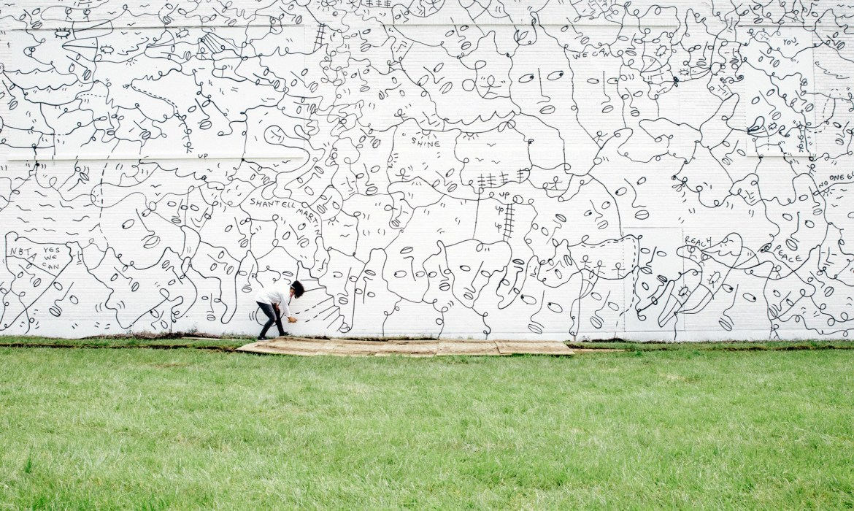
Murals
@Shantell Martin
Dance Everyday, Buffalo, NY 2017
Notes:
https://shantellmartin.art/work/dance-everyday/
More about this project: https://buffalonews.com/entertainment/arts-and-theatre/shantell-martins-mural-signals-rebirth-of-east-sides-northland-corridor/article_1b29999f-b5c9-5b81-8b71-5c46d5d4dd75.html

Slide 8
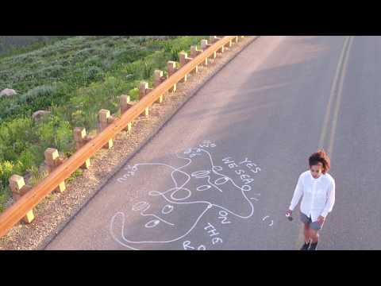
Drawing On Everything!
Video by: Shantell Martin, Theo Coulombe and Laksmi Hedemark.
Notes:
Notes from YouTube Video:
“During the last 10 days of July of 2017, I embarked on the quintessential American cross-country road trip with photographer Theo Coulombe and film director Laksmi Hedemark.
Together we traveled from the West coast back to my studio in Jersey City. I loved exploring the open road as a canvas and creating unique, temporary drawings along the way.” -Shantell Martin
Video Source:
https://www.youtube.com/watch?v=xzOJIhxFlCA&feature=emb_title

Slide 9
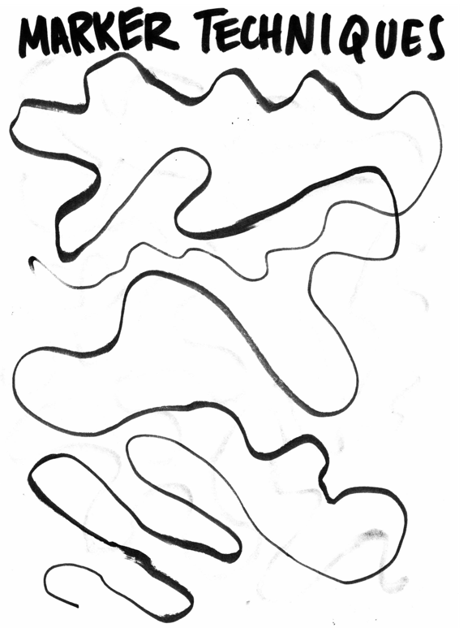
Detail Ideas & Marker Techniques

