Slide 1
Rosa Bonheur
1822-1899
Notes:
‹#›

Slide 2
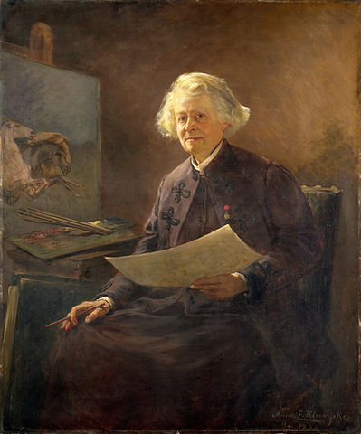
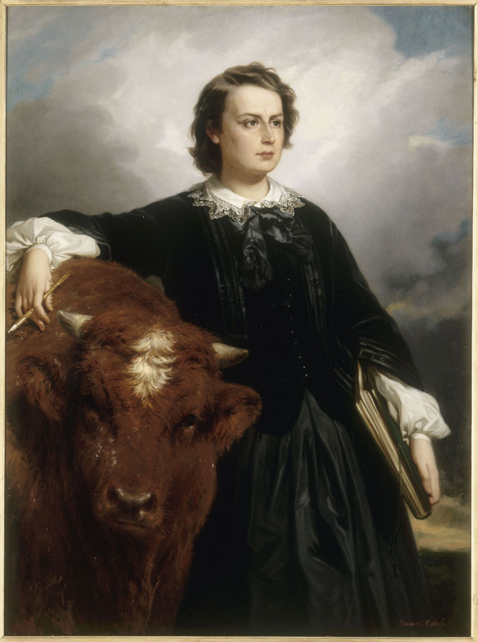
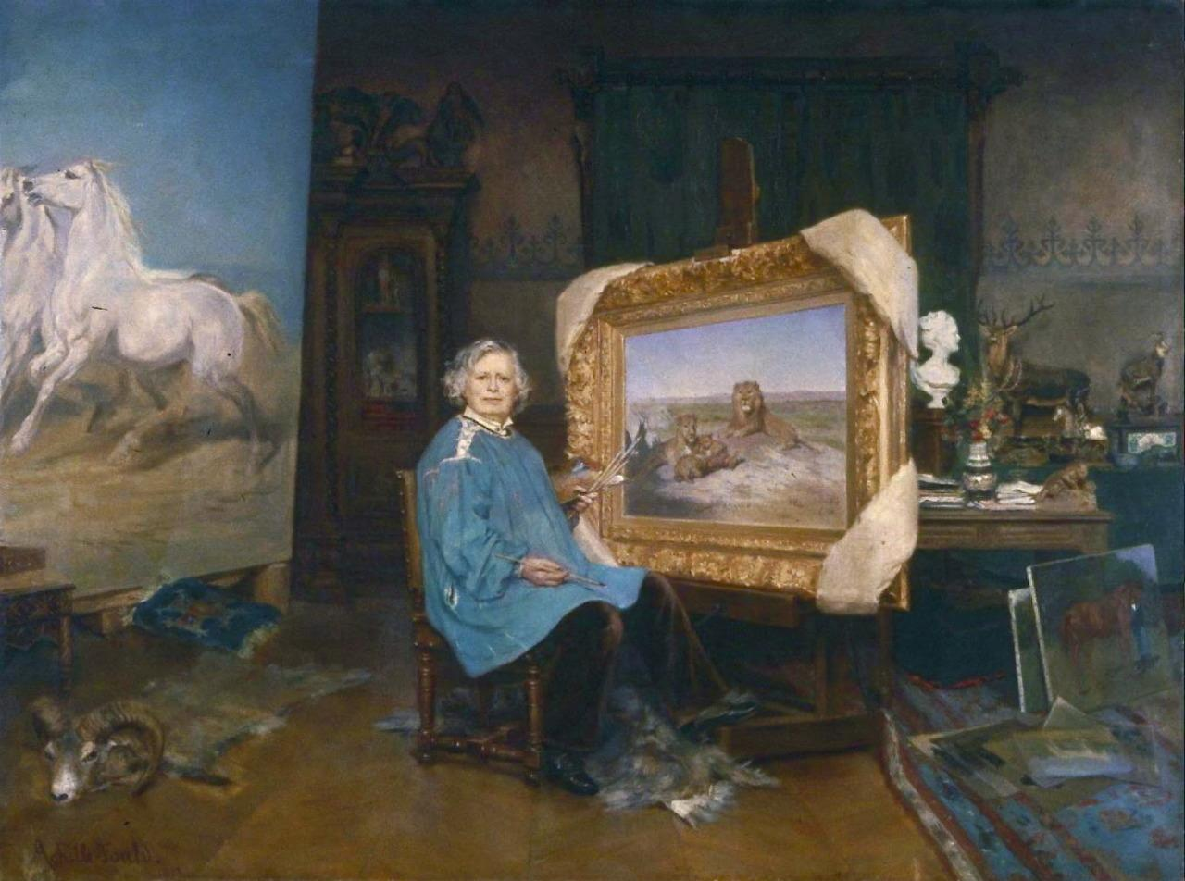
Rosa Bonheur
Notes:
Born in Bordeaux, Bonheur was one of four children in an artistic family. Her father was a successful painter. He raised his children to have a deep sense of social equality and was their art teacher.
Rosa began her artistic training with her father at the age of 13, and at the age of 27 she was a celebrated, successful and respected painter. He taught her in the standard procedures of copying engravings and plaster casts, drawing still-lifes, and later copying paintings of the masters in the Louvre.
As a painter, she is grouped in with the French Realists. She valued realistic depictions of the world and in her most favored subject matter: animals. Rosa’s love of animals led her to the Paris slaughterhouses to study animal anatomy. She had a successful career as an animaliere, a painter of animals.
‹#›

Slide 3
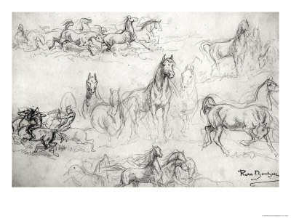
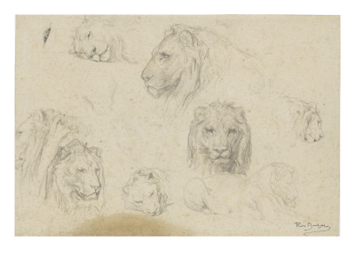
Study of Elk, Horses, and Lions
Notes:
Rosa created such realistic paintings of animals which were aided by her hour less time spent sketching. From the time she was a little girl, she was always drawing animals, doing quick little sketches that helped improve her skill as an artist. Practice, practice, practice! Here we see her study of elk, horses, and lions.
Bonheur was deeply committed to painting realistic animals. She would spend a lot of time practicing drawing the animals as seen here in these sketches. The result of all that practice was very realistic portrayal in her paintings.
‹#›

Slide 4
Rabbits Nibbling Carrots, 1841
Notes:
When Rosa was 19 years old when she created this painting. It was submitted and accepted into the Salon.
‹#›

Slide 5
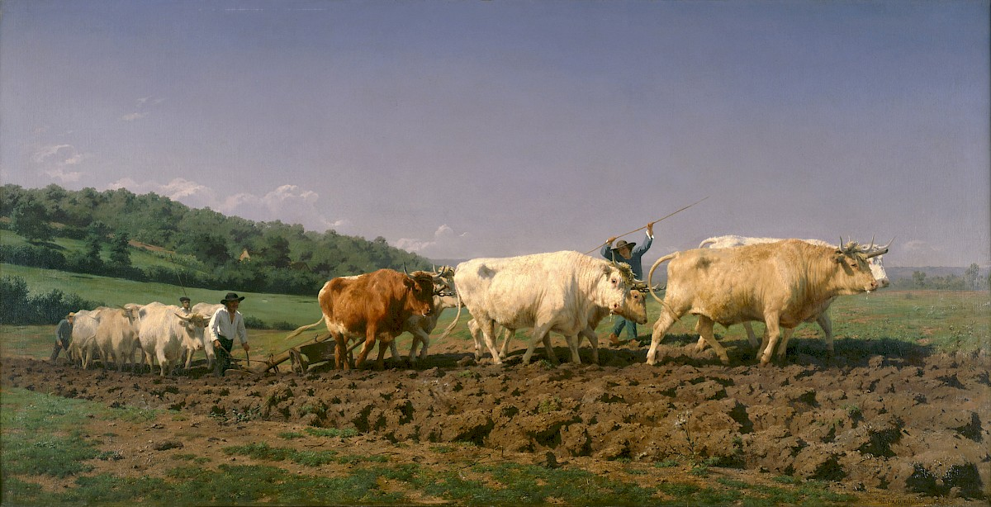
Plowing in the Nivernais, 1849
Notes:
With increased fame and after receiving several prizes from the Salon in recognition of some of her paintings, the French government hired Rosa to paint this picture. It is painted so realistically, it almost looks like a photograph.
She exhibited this painting in the Paris Salon in 1842. At the time, it was considered one of her greatest works. She depicts a team of oxen pulling plows across a French countryside.
‹#›

Slide 6
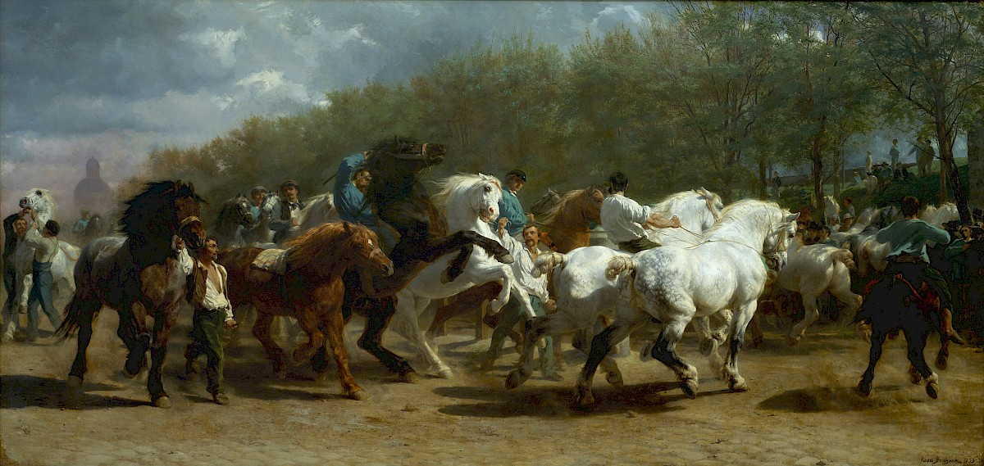
The Horse Fair, 1852-55
Notes:
Rosa Bonheur painted The Horse Fair (ca. 1853) from a series of sketches she made at the Paris horse market. This is Bonheur’s most famous work.
In 1853, Rosa exhibited what was to become her masterpiece – The Horse Fair. The painting made her an international celebrity. Rosa referred to this painting as her “Parthenon frieze”.
This large-scale piece measures nearly 17 feet in length. She often visited the Paris horse market to sketch. “For a year and a half Bonheur sketched there twice a week, dressing as a man to discourage attention.” (metmuseum.org)
In this painting she depicts horse merchants bringing their beasts to auction. Notice all of the drama she created from the energy of the horses and the struggle of the men trying to control them. How does she show movement?
This painting was so successful that it went on tour, showing in Belgium and England. Later, the painting made its way across the Atlantic Ocean and was purchased by Cornelius Vanderbilt who later donated it to the Metropolitan Museum of Art in 1887.
‹#›

Slide 7
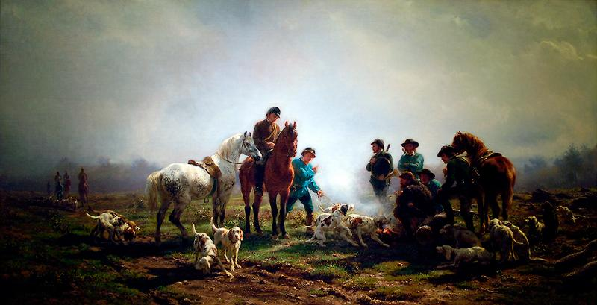
Gathering for the Hunt, 1856
Notes:
In this painting we don’t see the sun, but we know that it is shining. How? Which direction is the sun shining from?
‹#›

Slide 8
Sheep by the Sea,1855
Notes:
Notice the careful way Rosa painted the shadows on the grass in this painting. Using darker colors below the sheep helps make them look more “rounded” and realistic – just like real sheep!
‹#›

Slide 9
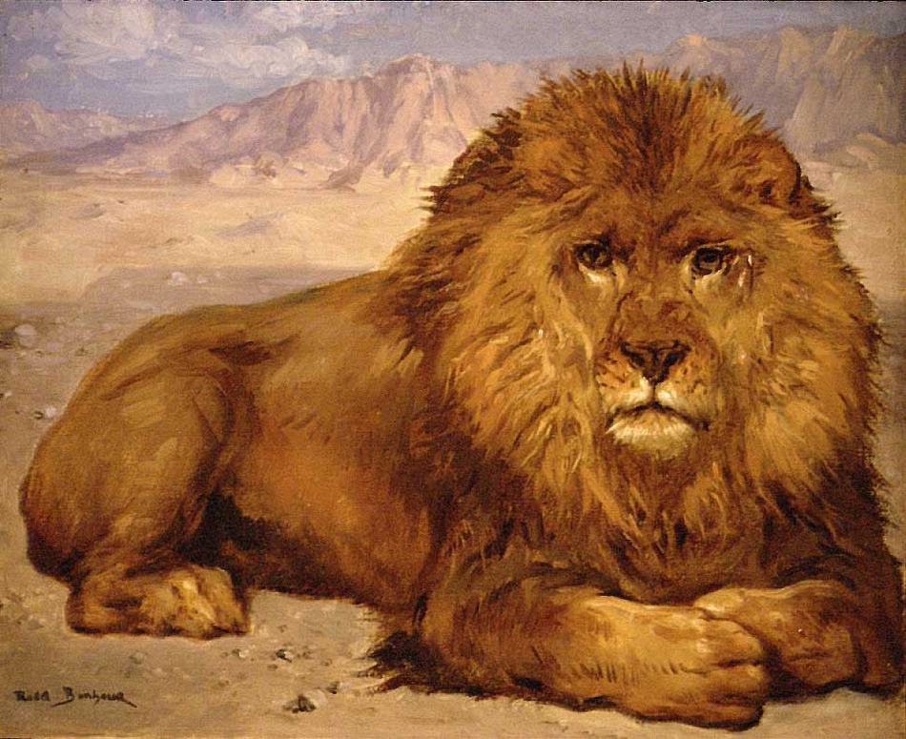
Lion at Rest, 1880
Notes:
In addition to horses, lions were also one of Rosa’s favorite animal subjects. After earning enough money from her art, she bought a large home in the country with a studio. She brought many unusual animals to live there after she painted them. Some of them were – a monkey, a yak, an eagle, an otter, a wild boar, and three lions!
‹#›

Slide 10
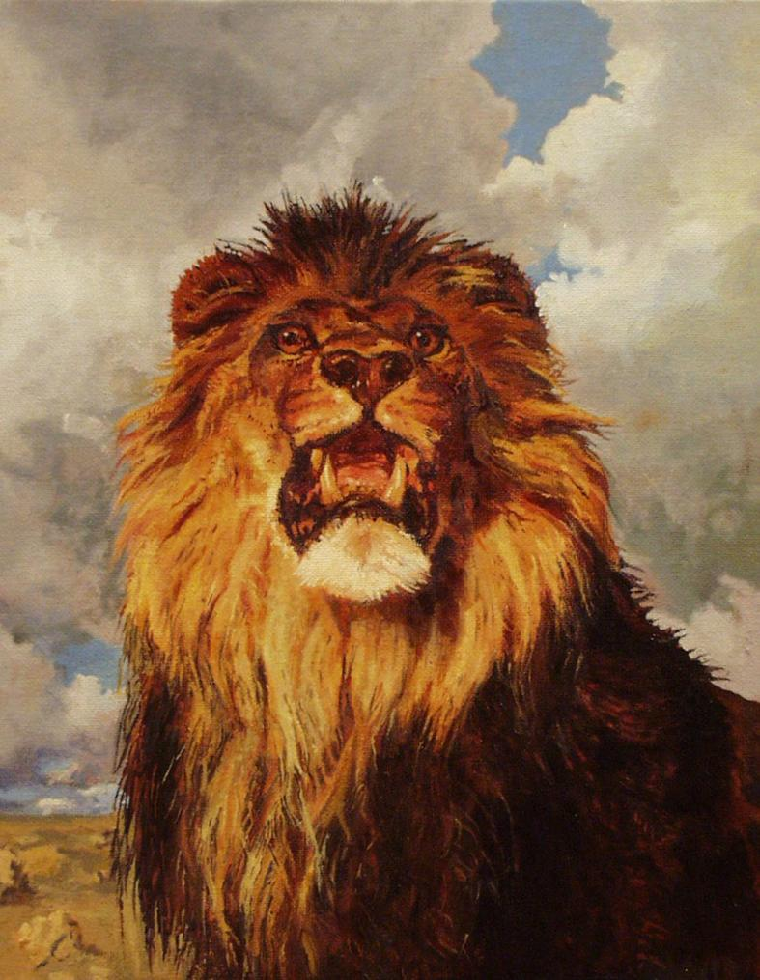
King of the Desert
Notes:
Does this painting frighten you? Are you convinced of the Lion’s ability to roar?
‹#›

